Slide 1
Ruby Scripting Basics

Slide 2
Introduction
Useful as a scripting language
script: A small program meant for one time use
Targeted towards small to medium size projects
Use by:
Amazon, Twitter, Yahoo!, White Pages, Reddit

Slide 3
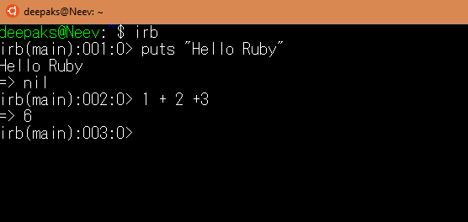
Ruby Interpreter
Allows you to type commands one at a time and see results

Slide 4
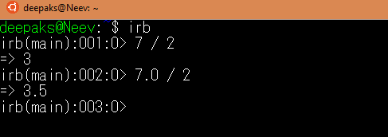
Expression
Arithmetic is similar to Java
Operators similar to Java
+ - * / % (plus ** for exponentiation)
Precedence
() before ** before * / % before + -
Integers vs Real Numbers

Slide 5
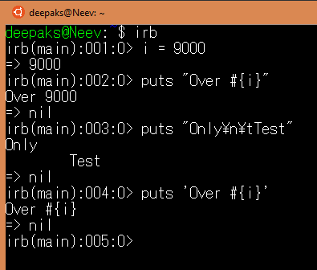
Declaring String

Slide 6

Variable/Types
Don’t declare types
Ruby is looser about Types than Java
Type of variable can change throughout program

Slide 7

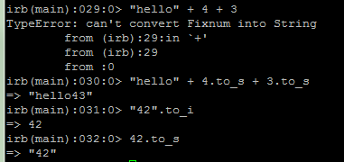
Strings and Ints
Strings can be multiplied by integers
Concatenates string repeatedly
Integers and Strings cannot be concatenated in Ruby
to_s – converts to string
to_i – converts to integer

Slide 8

Constants
Ruby doesn’t really have constants
Instead declare a variable at the top of your code and it will be accessible everywhere
You will get a warning if you change a constant, but you can change it anyway (bad style)

Slide 9
Methods and Parameters
Parameters are declared by writing their names (no types)
def my_method (a, b)
puts a + b
end
Calling Method :
my_method(1, 4)
my_method(‘HI ‘, ‘Hello’)
my_method([1, 2], [4, 2])
You will get a warning if you change a constant, but you can change it anyway (bad style)

Slide 10
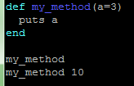


Default Parameters
You can give a default value to parameters
The caller doesn’t have to pass a value
You can also explicitly return values, and this is less error prone

Slide 11

Reading Input

Slide 12
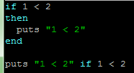
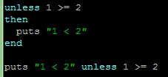
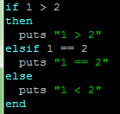
If Statement
Nested If :

Slide 13

Loops : For
i = 0
loop do
i += 2
puts i
if i == 10 break # this will cause execution to exit the loop
end
end

Slide 14


Loops : while

Slide 15
Thanks!
Any questions?
You can find me at @Ethans & deepak2717@gmail.com

